Slide 1
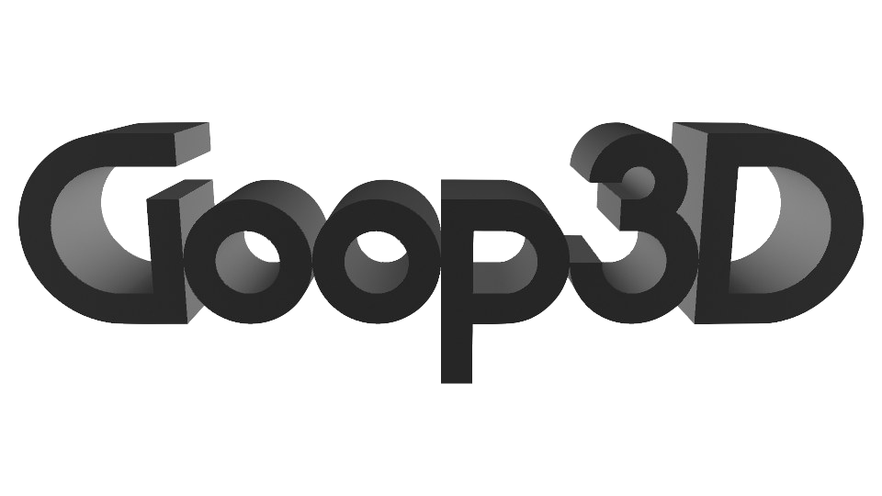
A tool for creating 3D models of marine microbes from 2D cross sections
Challenge: Iron Out the Kinks
Stakeholder: Dr. Aaron A. Heiss
Hack the Deep 2018

Slide 2
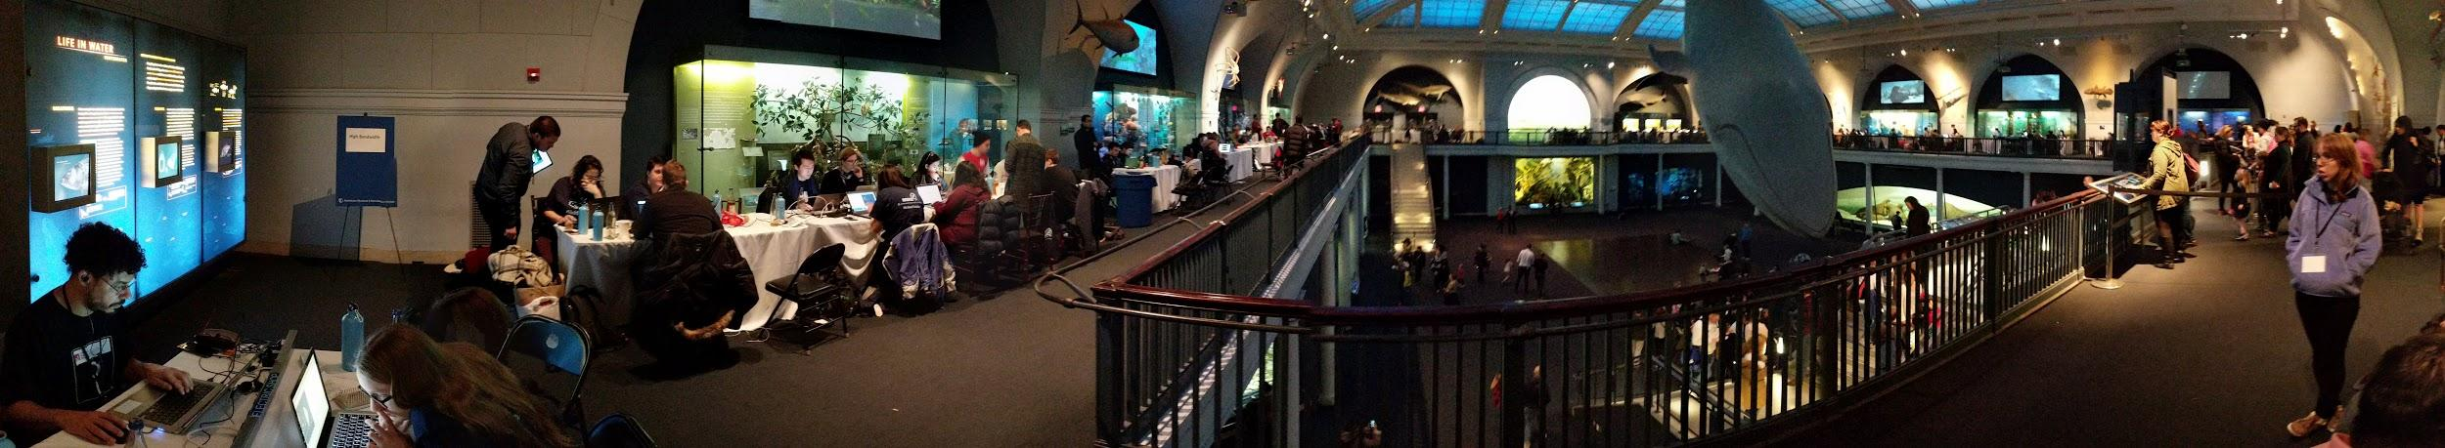
Hack the Deep @ AMNH
Notes:
We're a plucky group of strangers who came together for the hackathon and brought disparate skills together!
2 Web developers, a designer and a Developer in the realm of vfx
“Team Goop”
Here we are at the hackathon not in our seats -- Synchronized bathroom break? Blood was probably 30% coffee!

Slide 3
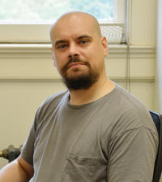
Working with Aaron
Notes:
This is Dr. Aaron Heiss, a Post Doc researcher at the museum who’s in the audience tonight!
He is the stakeholder for the challenge we worked on.
He’s one of a handful of people on the planet studying the anchoring apparatus of the flagellum of certain protists.
Some people get excited about discovering new species but Dr. Hiess has discovered entire phylums!
He gave us a tour of his lab and showed us the many pieces of equipment and machinery required to do his work.
Aaron was really helpful and supportive; he stuck around for most of the night answering questions
We felt like we were going to help him make a big difference to his field

Slide 4
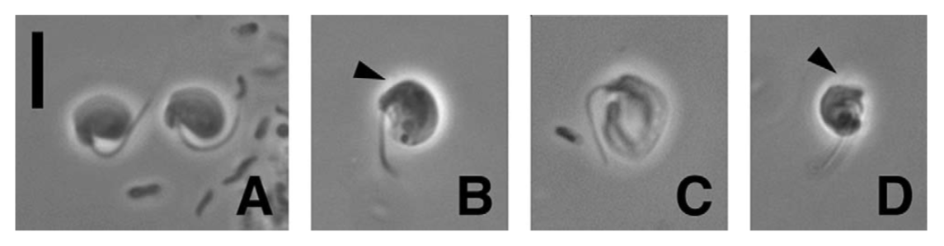
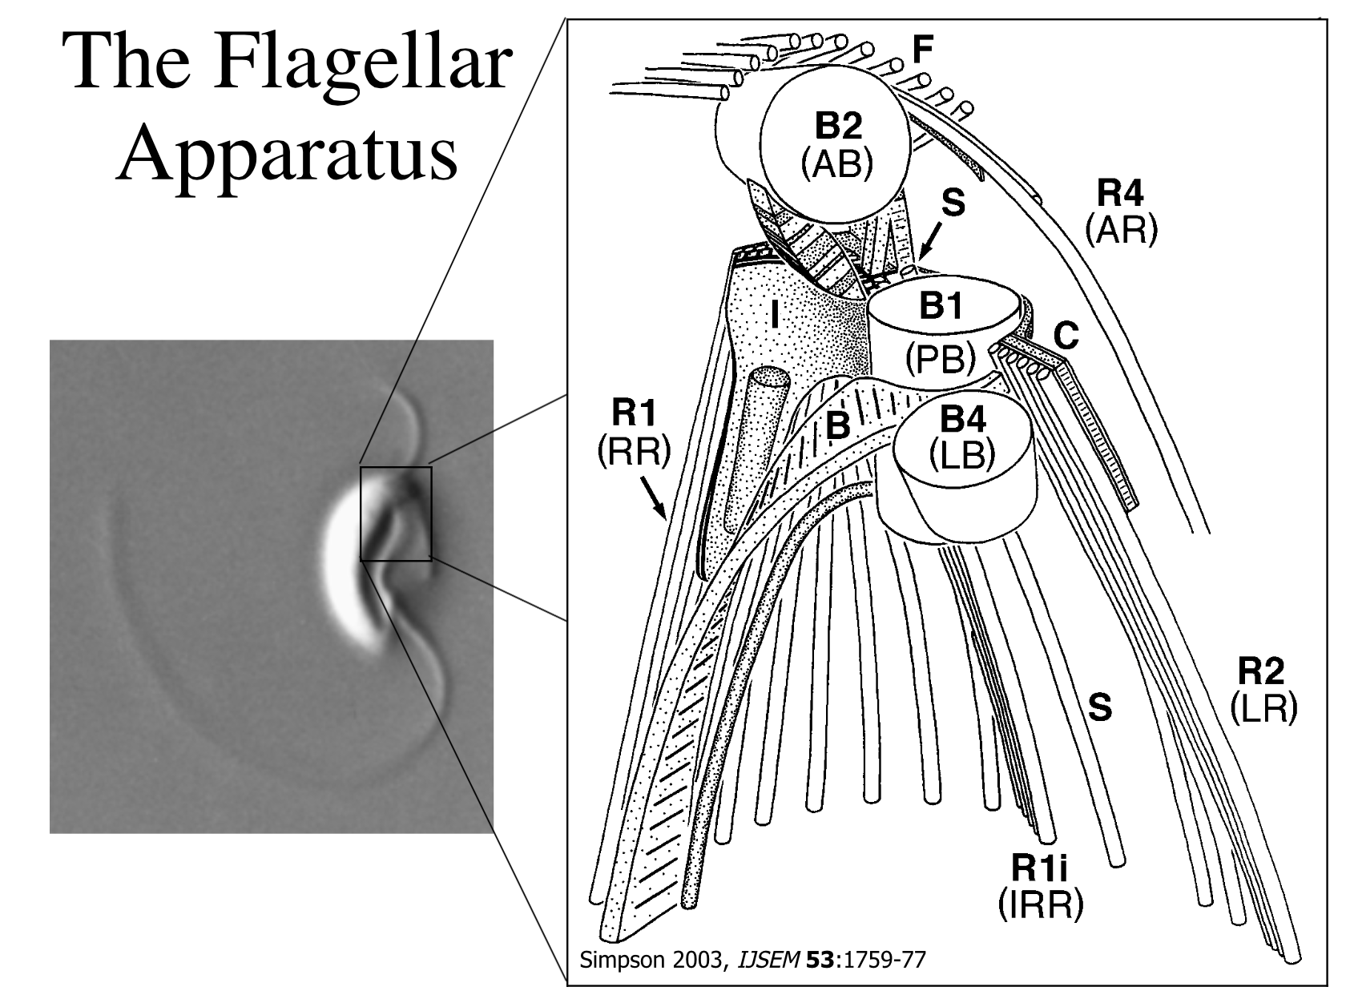
The Challenge
Notes:
The oceans are home to vast multitudes of micro-organisms. Up to 90% of the biomass in the ocean (the weight of all its life) is made up of single-celled microbes (and not, in fact, giant whales as previously pictured!)
Dr. Aaron Heiss studies some of these organisms, in particular the micro-cellular structure of protists.
Origin of ‘team goop’
Extremely cute Ancyromonas sigmoides in action!

Slide 5
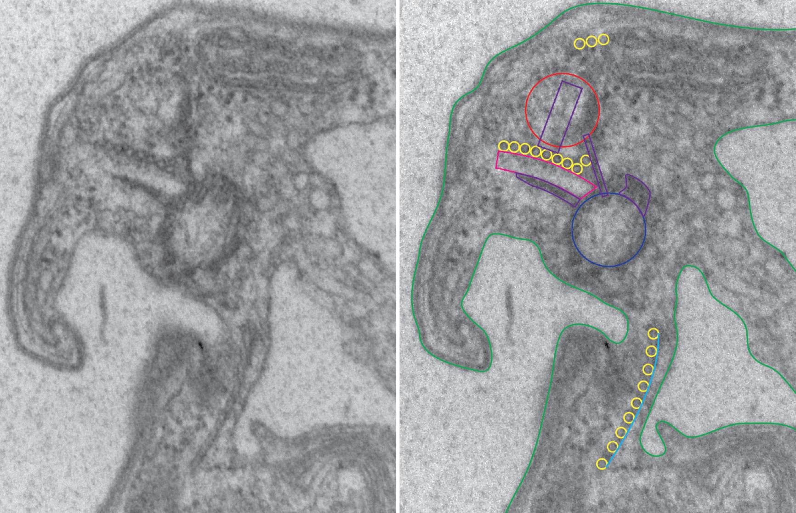
Notes:
Aaron makes 3d models of these organisms by taking cross sections like this one from a transmission electron microscope, or TEM)
50-70-nanometer-thin "deli slices" are created by single-atom wide diamond blade of a machine called an ultramicrotome
Depending upon its size, a single cell cut this thin can produce between eighty to several hundred slices
photos are cleaned, graded, transformed, marked-up (annotated), lofted, rendered/printed…
SLOW

Slide 6
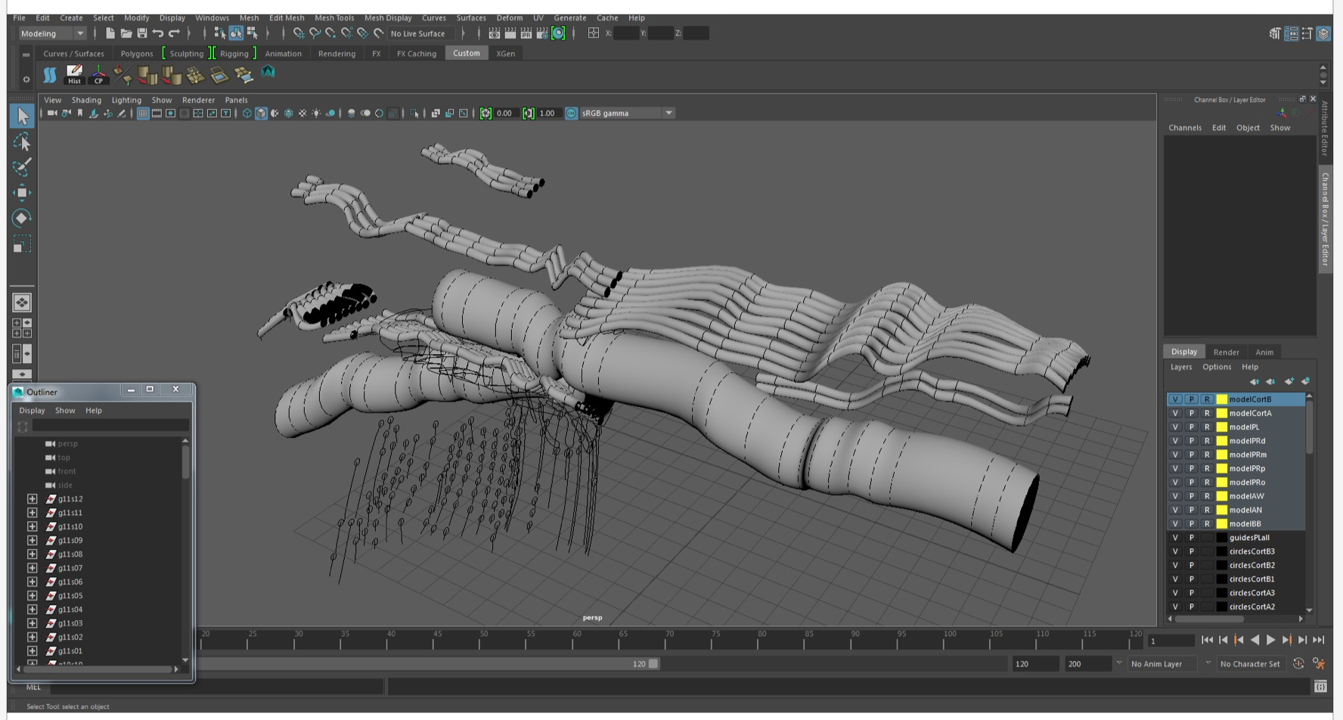
Notes:
The tubule structures are particularly important to Aaron and hard to get right in 3d
Hence his slow iteration loop and ‘iron out the kinks’

Slide 7
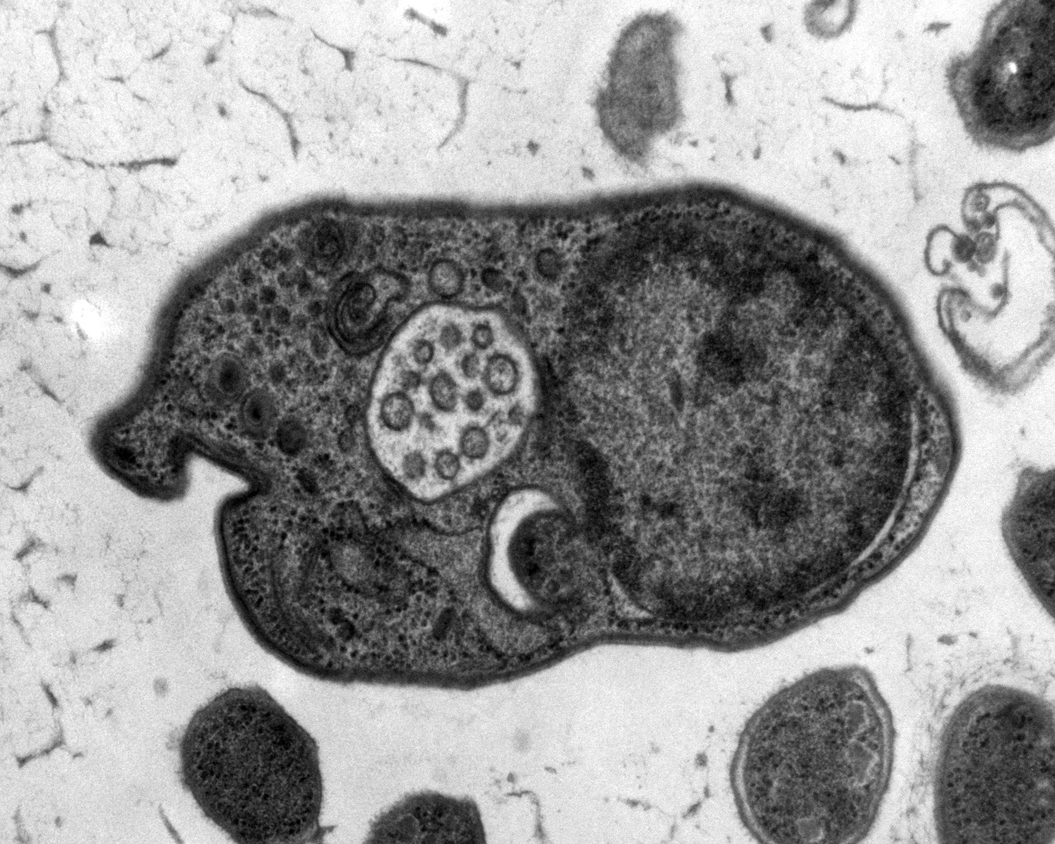
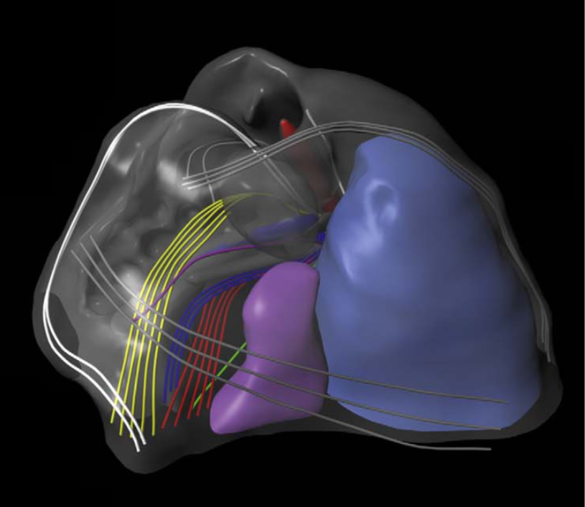
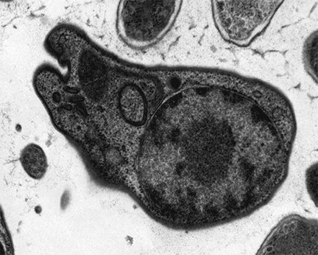
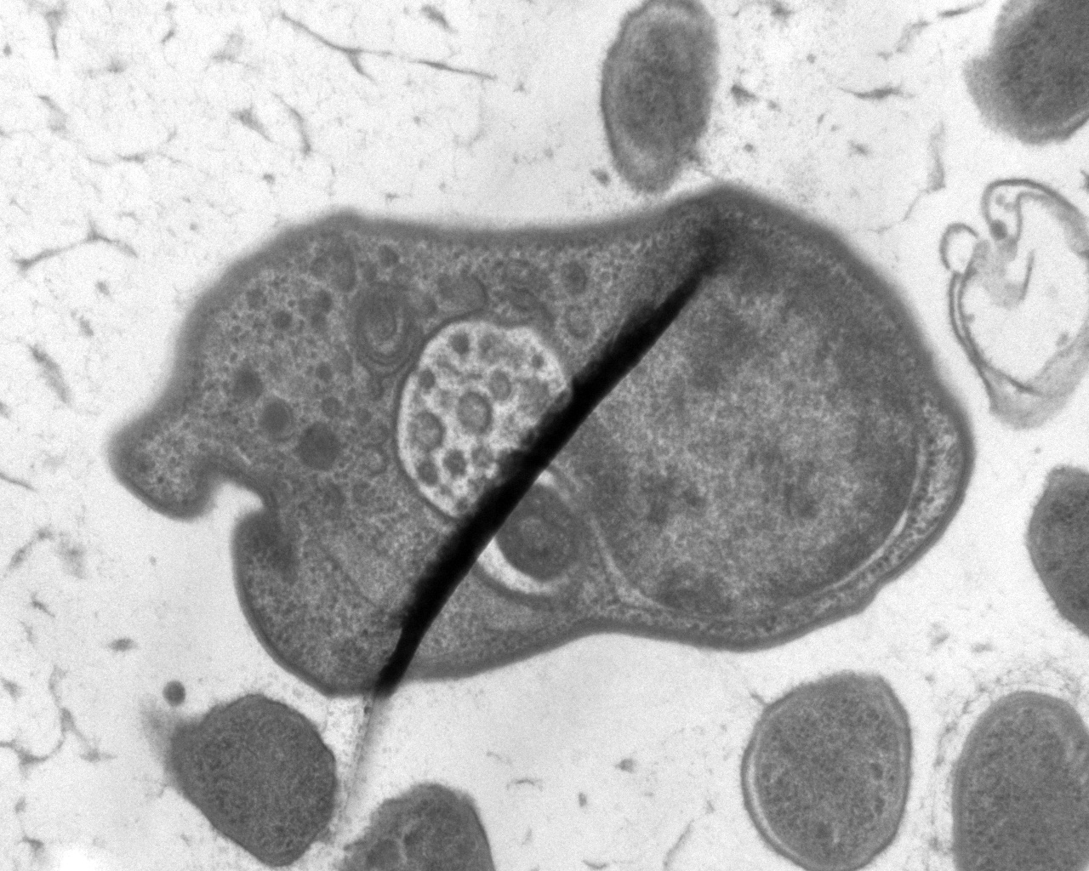
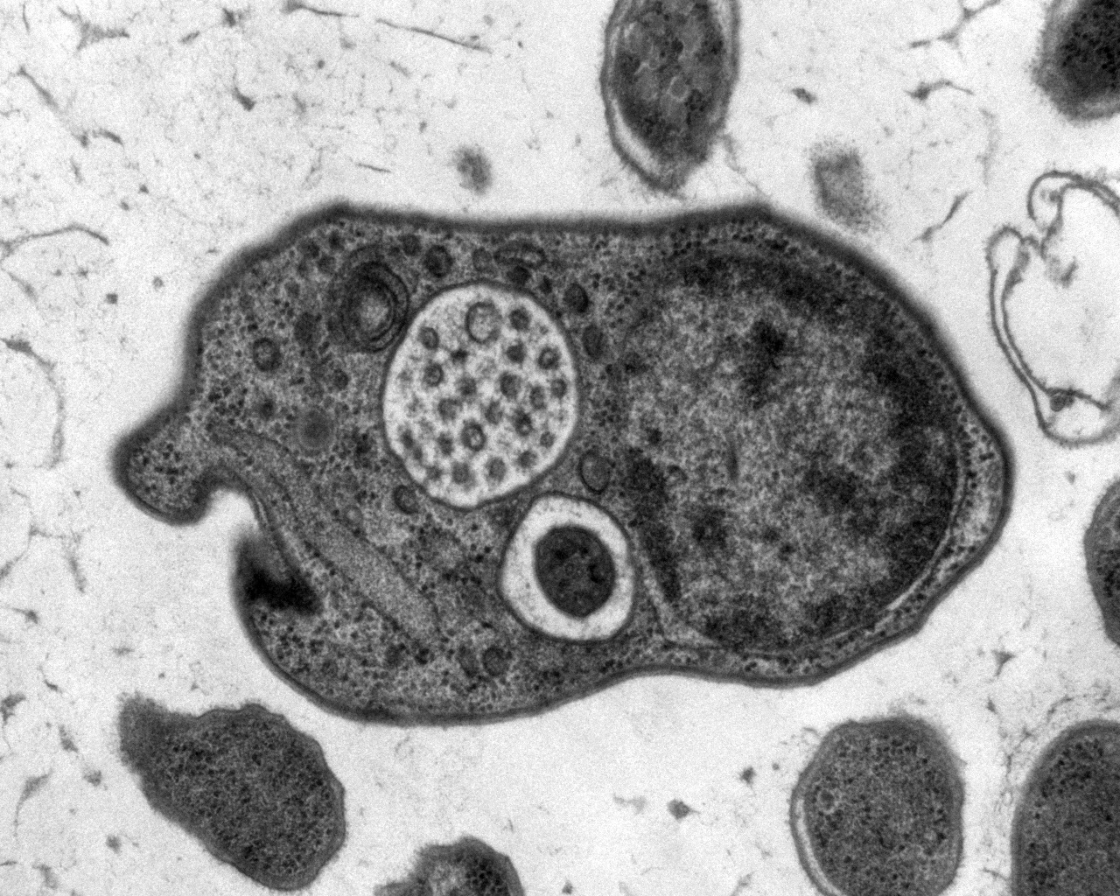
2D to 3D
Notes:
Eventually models / renderings like the image on right can be made.
This process from start to finish can take months
Aaron’s challenge: make the process of creating these “artistic” 3d models faster and easier
Aaron’s solution involved many apps / manual tweaking / slow iteration loop!
Our idea: A unified application for doing all the requisite manipulation / tracing / rendering “live”

Slide 8
The Design
Notes:
Ruled out existing software as being too complicated / user unfriendly -- wanted something more general
Discussed interface as a group throughout the evening during which Meret got to work on some mockups

Slide 9
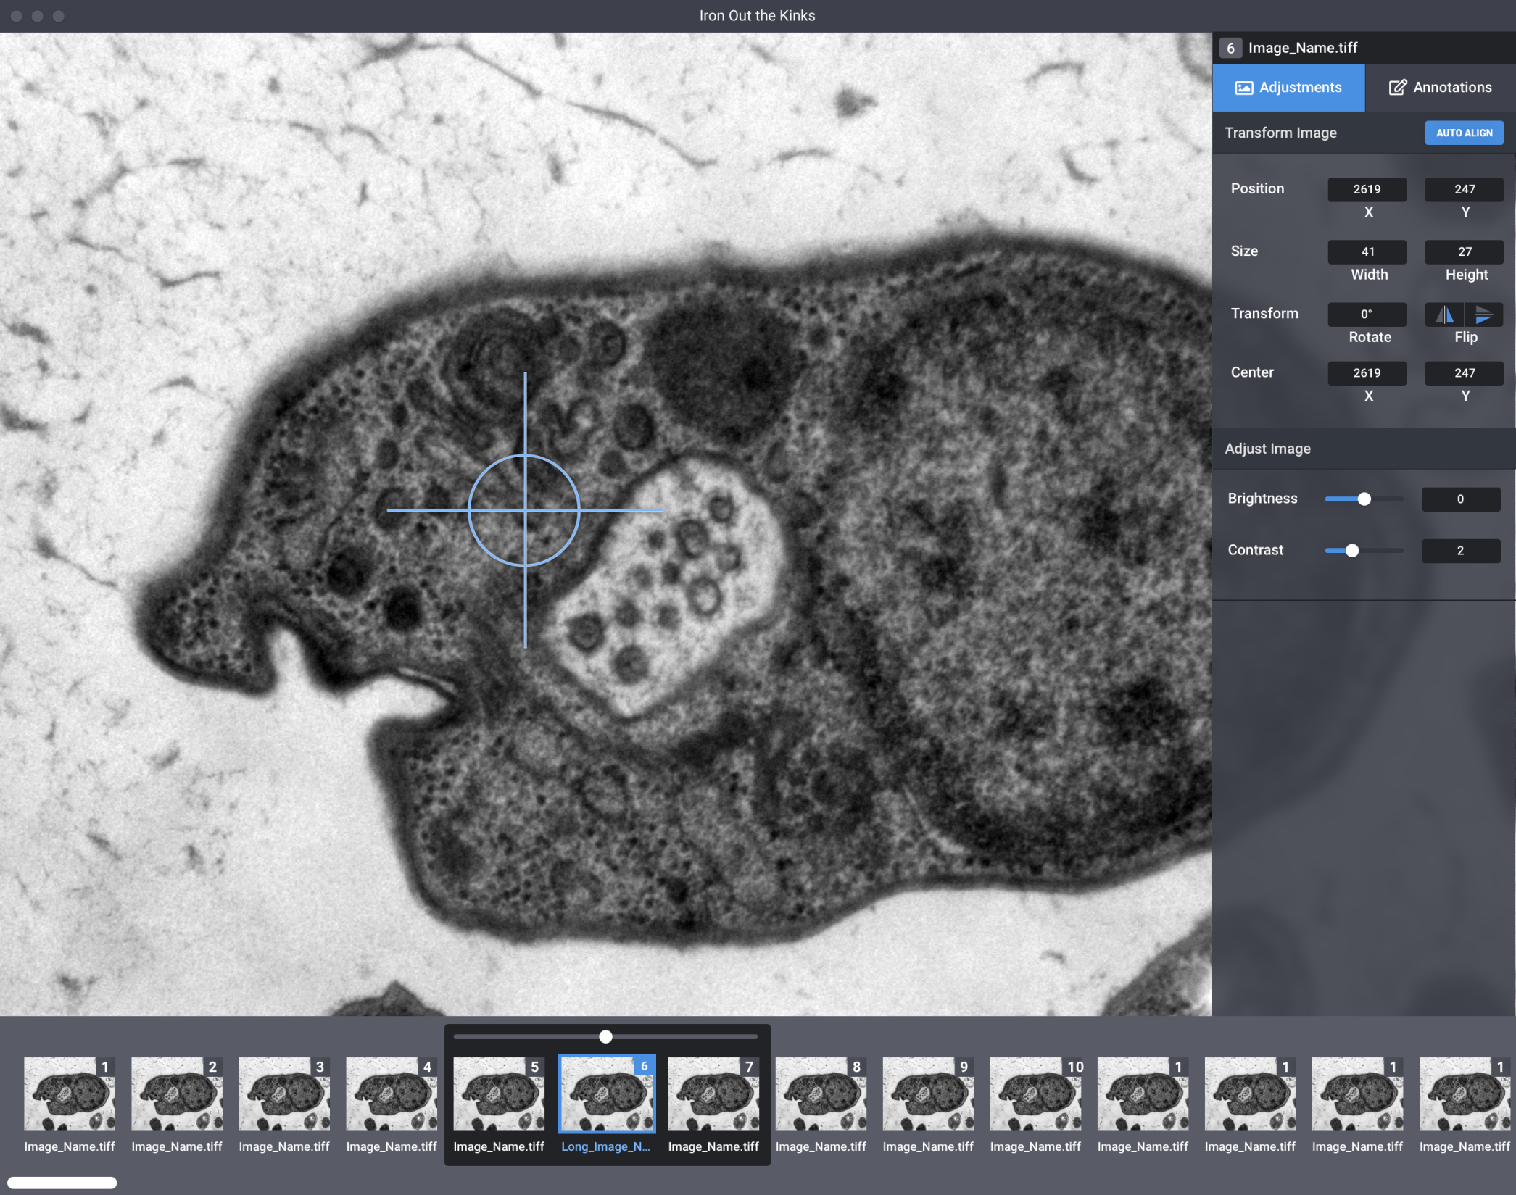
Image Adjustments
Notes:
Common image manipulation interface (photoshop / AI / nuke)
Spatial Transformations: move / rotate / scale
But also Color Corrections (contrast / brightness / denoising) etc
Opportunities for automation here (several hundred slices!) but more later...

Slide 10
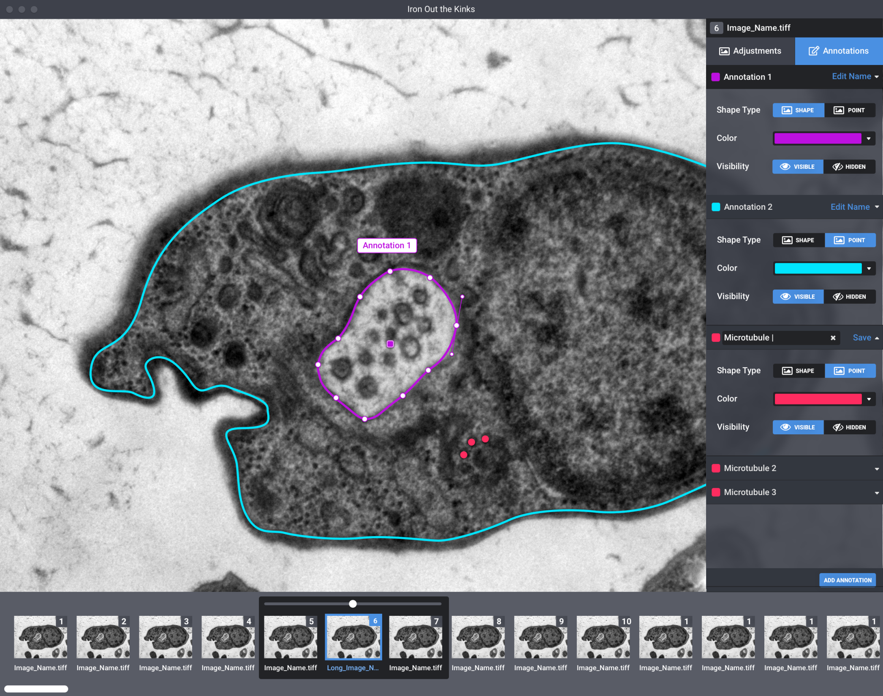
Tracing / Annotation
Notes:
Core of this part of app is anotation: the ‘naming’ of different structures by tracing them with different colored curves
Inspired by some VFX software interfaces that excels at this sort of curve management / manipulation
Hiding / showing / grouping
Special tubule (closed shape) annotation mode (this is the structure he’s studying the most closely)
Structures (not just curves) as first class citizens

Slide 11
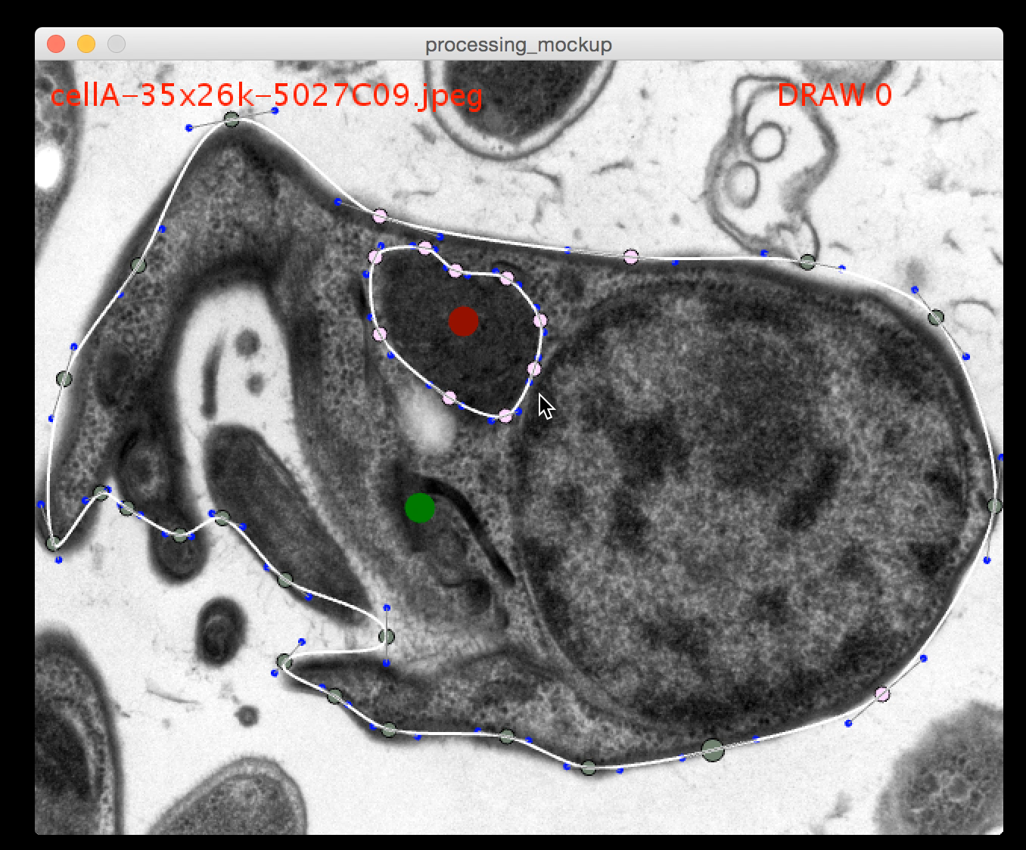
The Prototype
Notes:
Processing Prototype interface
Basic functionality -- be able to draw and edit curves
Missing ability to scale / rotate images for now…
But much more importantly….
Controls to move between frames
Persistent shapes across ‘frames’
Now we can say, “this bit is the same structure as in the last image”
Similar to Rotoscoping
Gives us: Interpolation + Onion skinning + “range” of structures in vertical depth

Slide 12

Export
Notes:
Here’s a visualization of those curves expored frame-by-frame without the electron microscope scans
imagine more curves, one for each cellular structure
Each is distinct .svg file

Slide 13
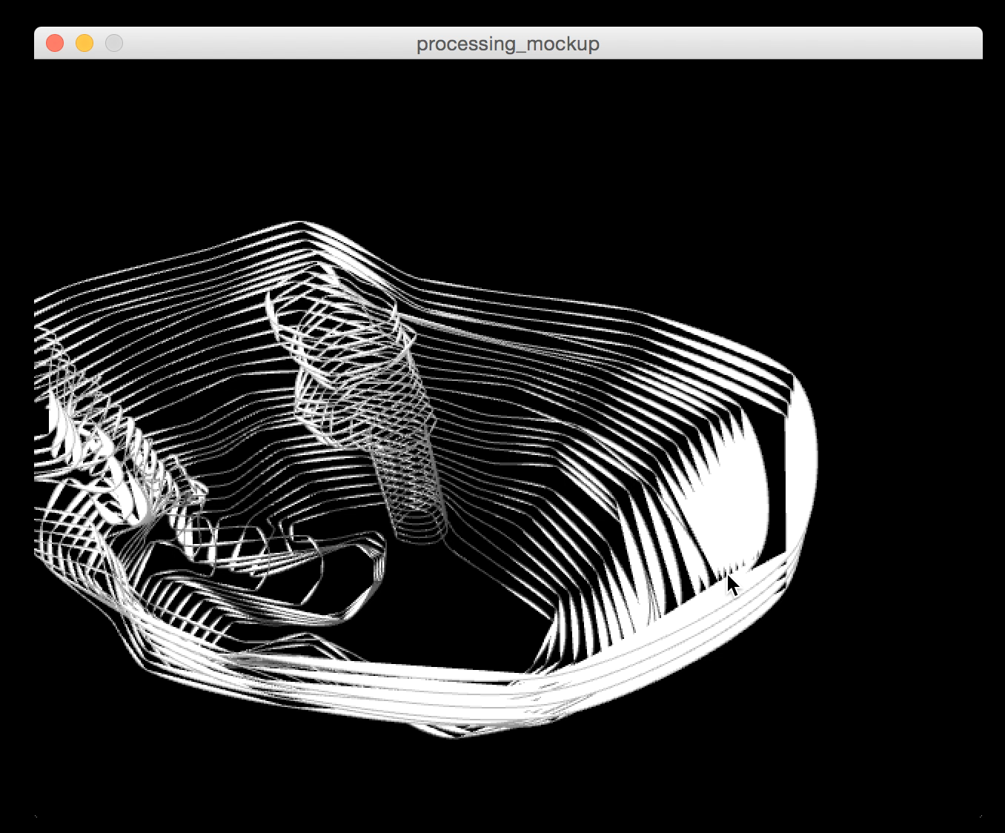
Preview in 3D
Notes:
Added in the last 2 hours before the end of the hackathon we realized we could visualize the curves in 3D with a “3D mode”.
Having this all in one app (even in this rough state) shows the power of tightening the iteration loop (see errors and fix in one app!)

Slide 14
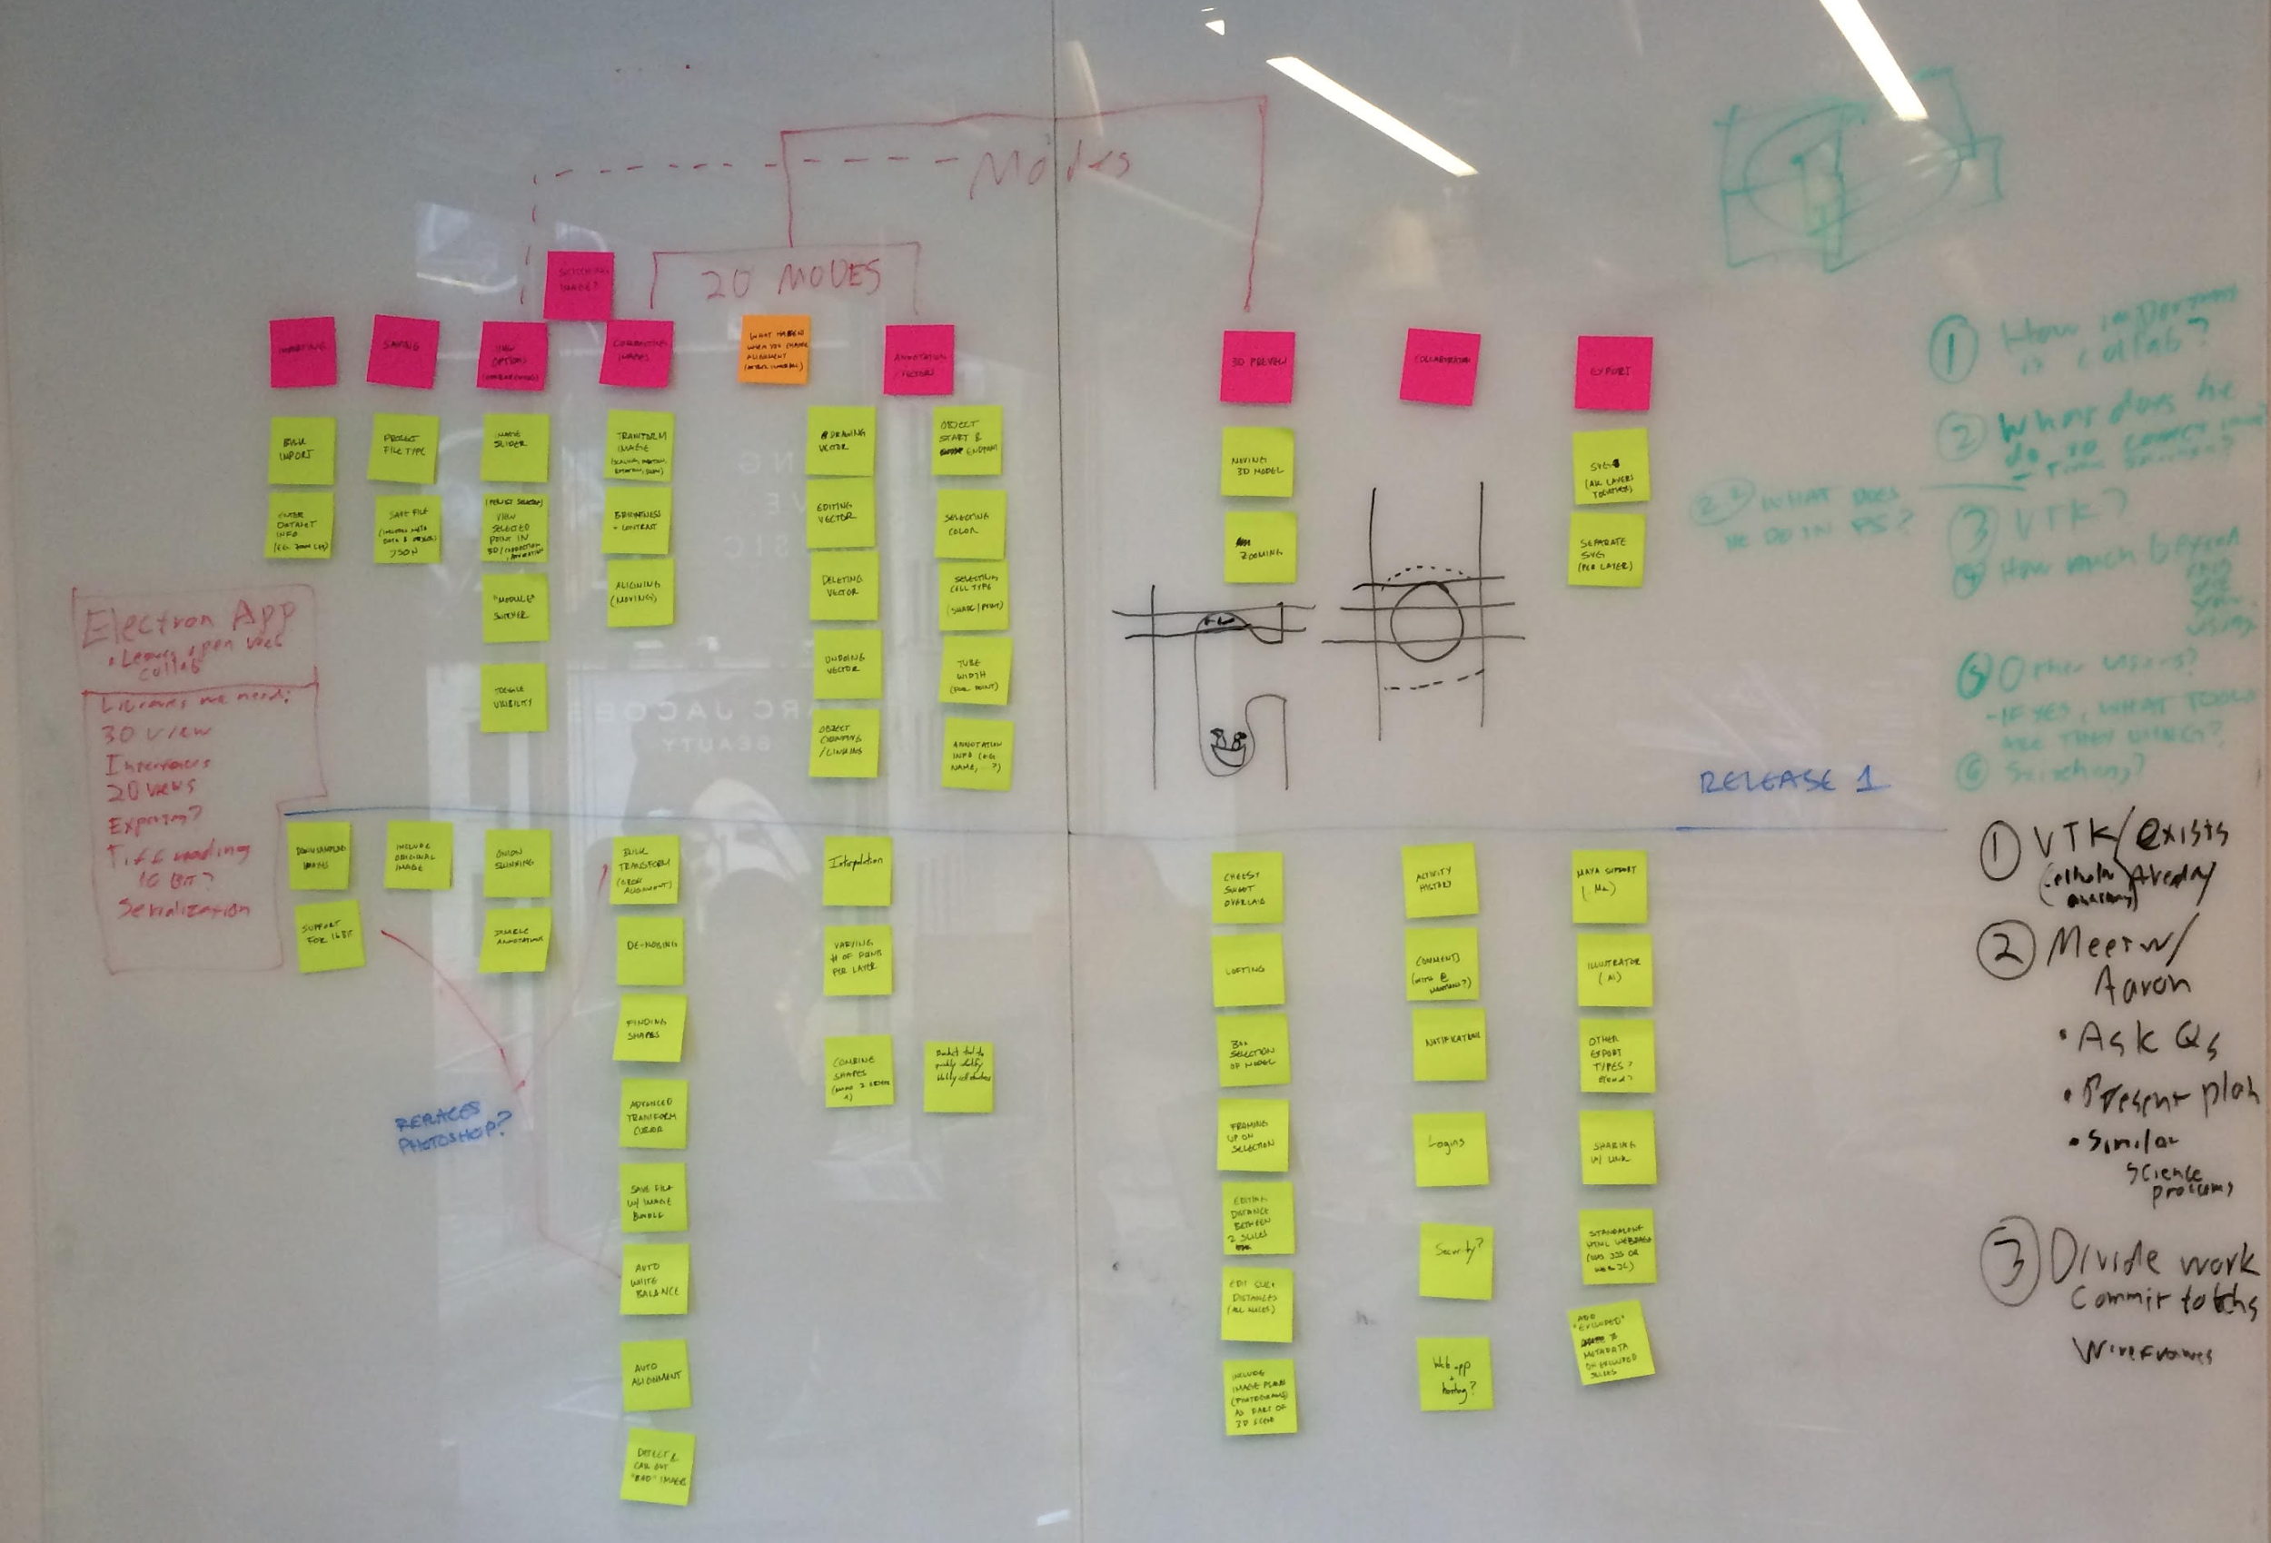
Post Hackathon Meeting 1
Notes:
Lots was done in haste during the hackathon -- time to get organized and build a real architecture for our app
Settle on javascript + electron to make standalone app (processing was never going to cut it!) which means rebuilding from scratch
Organize features into phases of development / importance
Discussion about collaborative features
Ability to export to different formats (.ma, a collection of curve files, obj etc)
Generate questions for Aaron

Slide 15
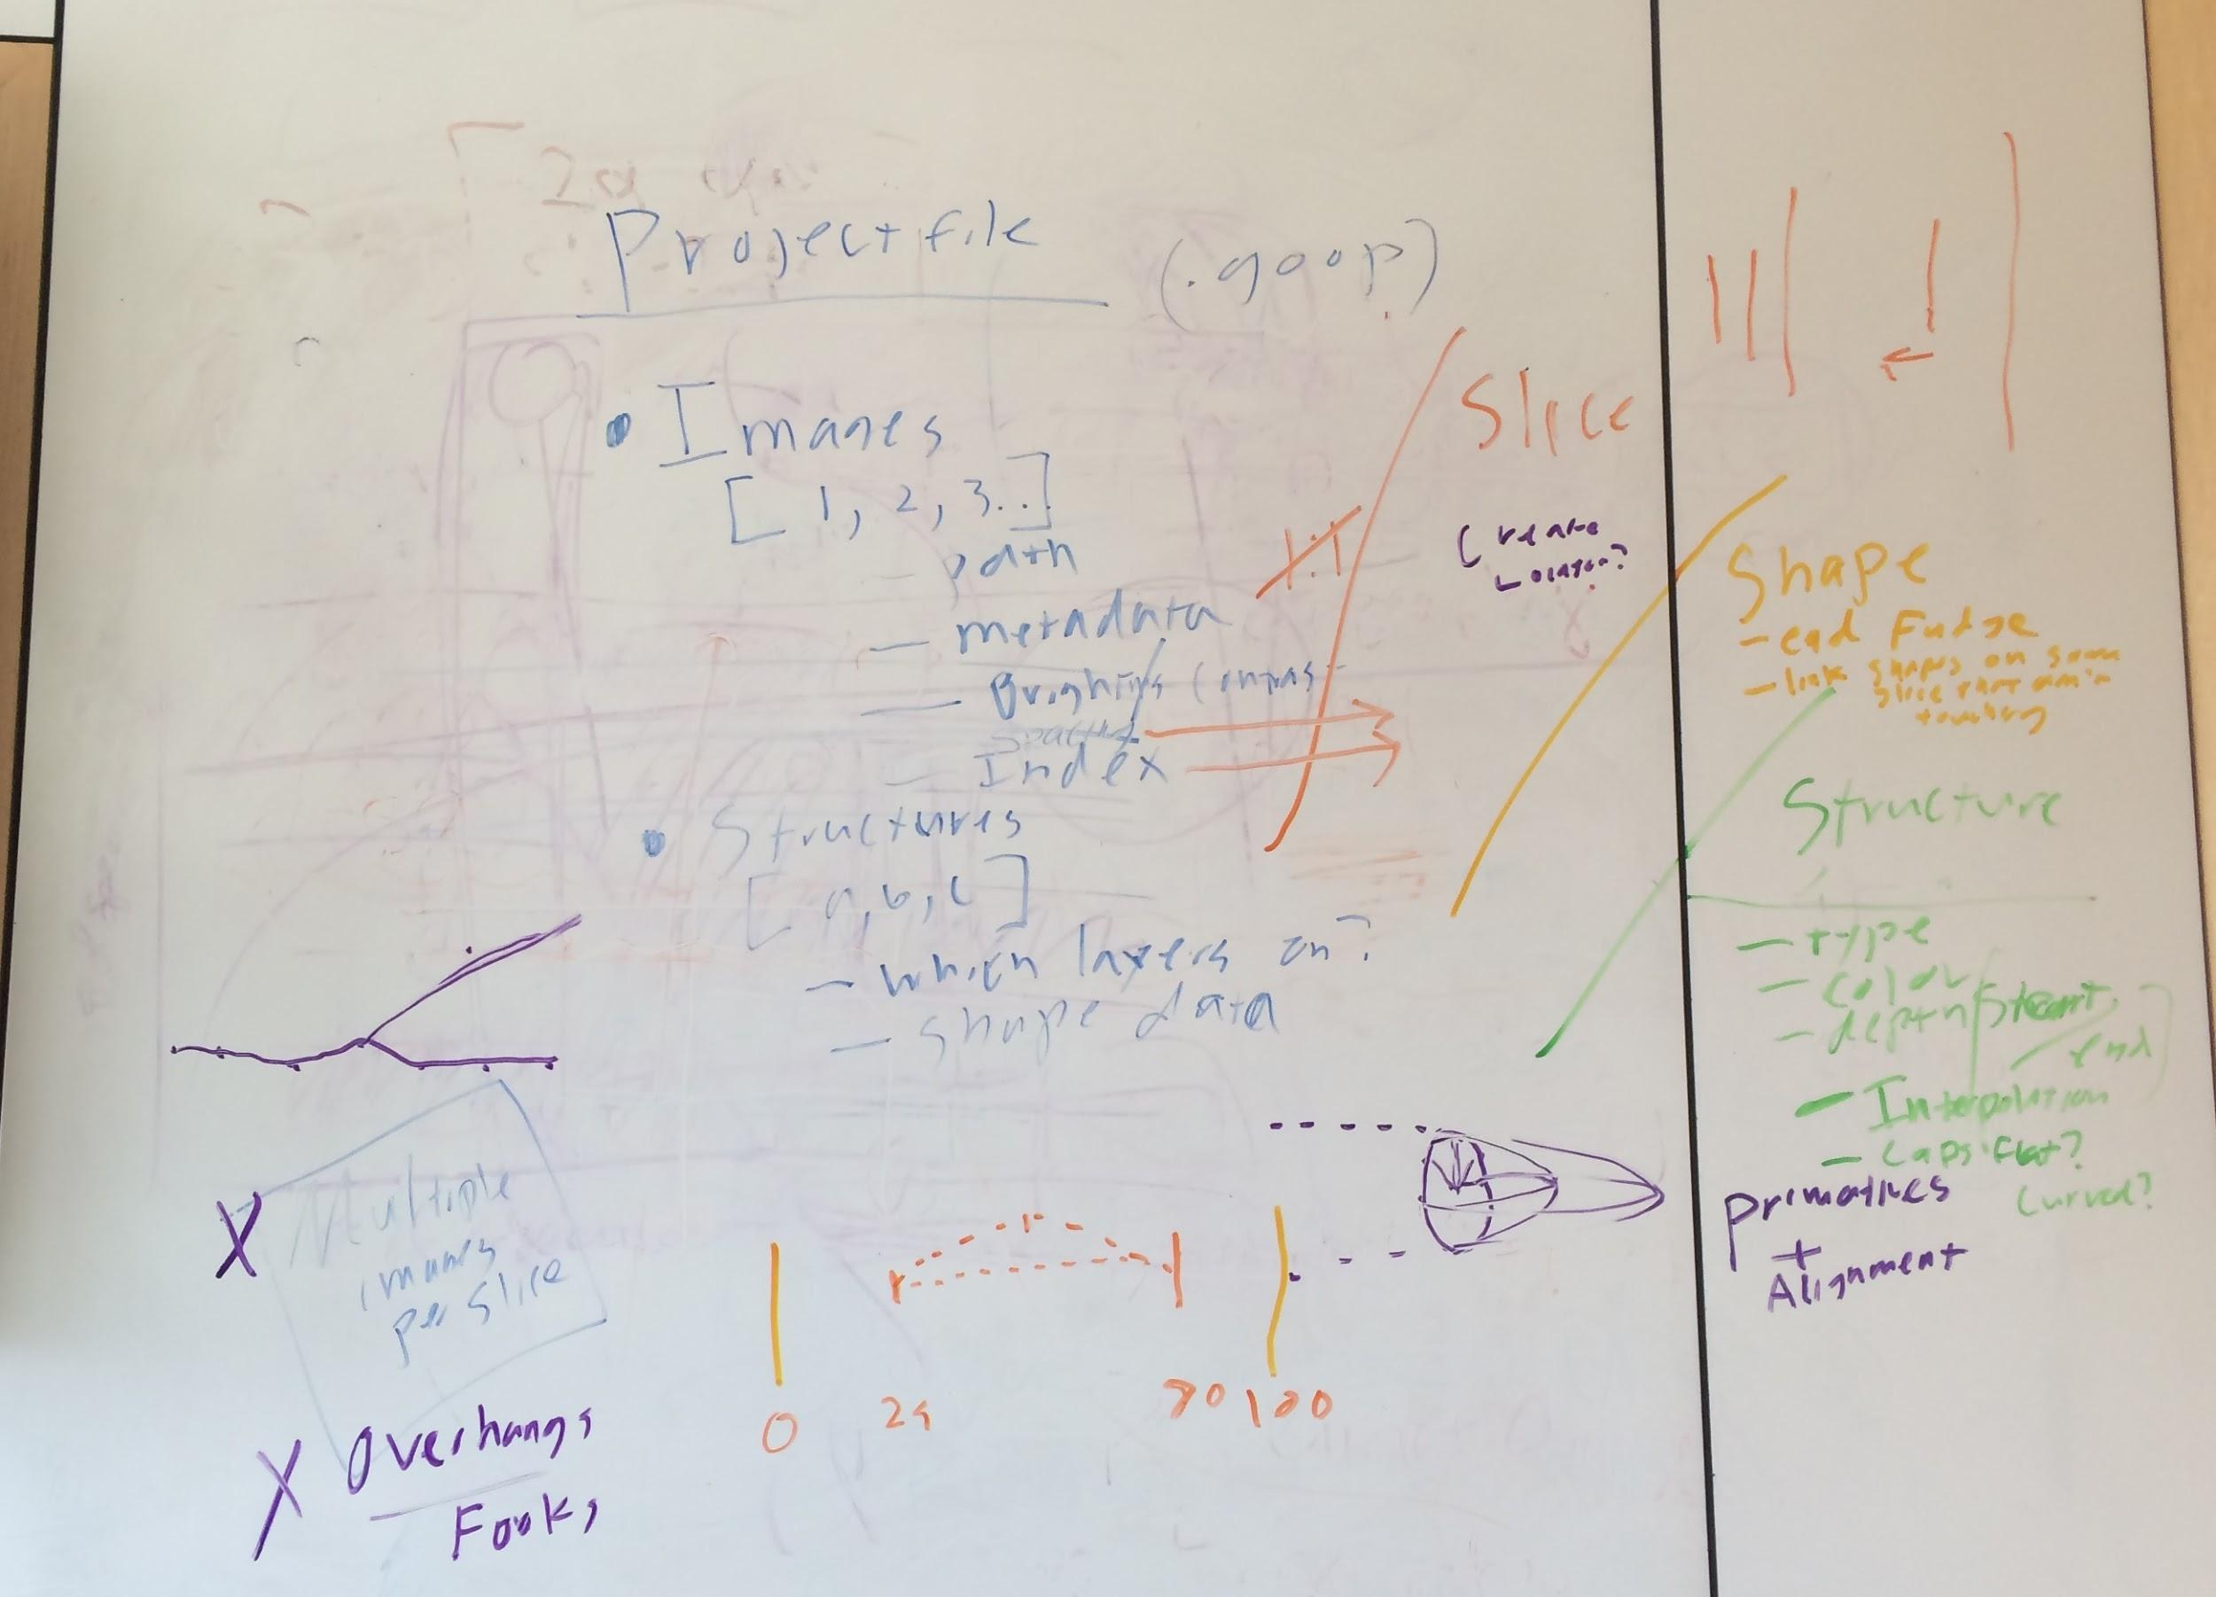
Post Hackathon Meeting 2
Notes:
With Aaron @ AMNH; Passed sanity checks
Organized work into epics and features
Focus on usability and UI now that we were meeting with stakeholder
...and the interface changes required to support this stuff
Codified plans into github issue tracker

Slide 16
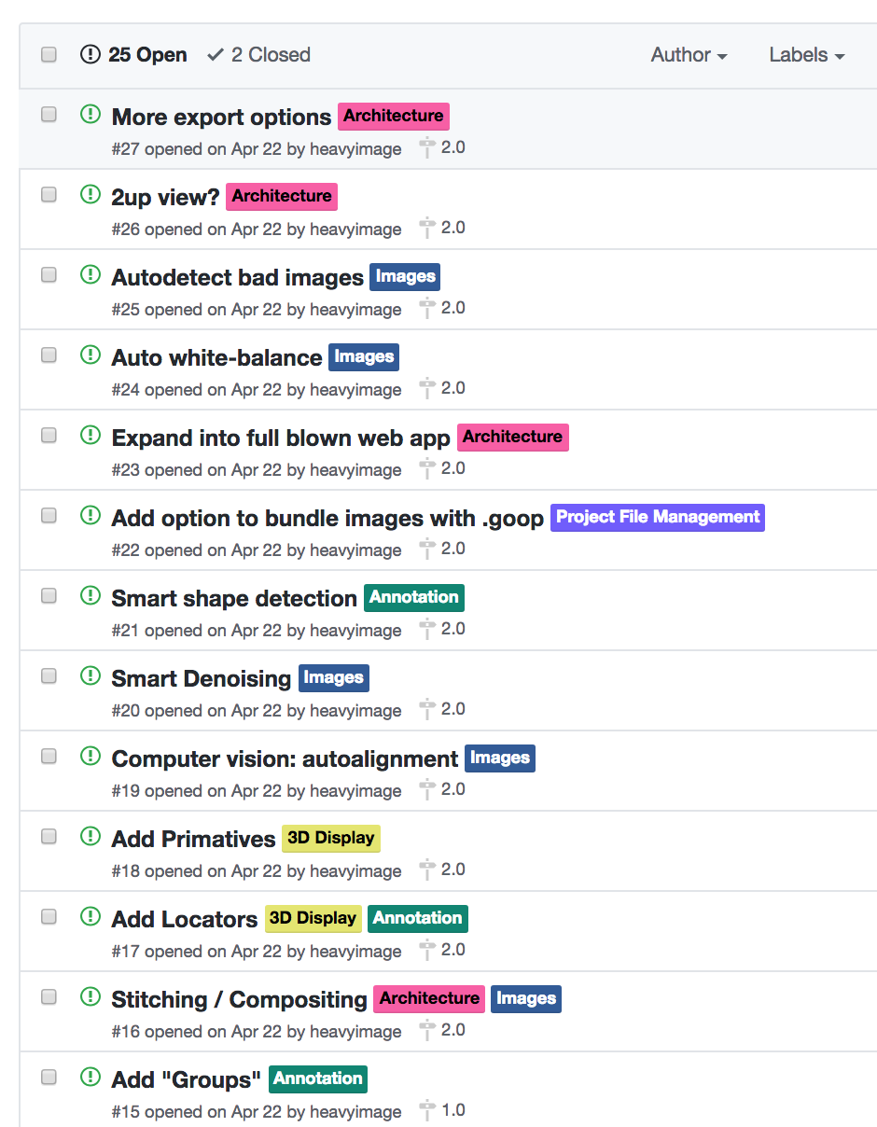
Where we are now
Notes:
Work is underway on our electron app. Stack sorted after a lot of hard work by Abe and Jennifer and images load!
Present main concern: get a full image → 3d model working in one app, if a bit manually
Standard app conventions (undo, shortcuts, 2 up views, selection modes) a lot of boring invisible work but important!
Then add some futuristic tech to help make things better (denoise, auto-align, autotrace)
Other exporters (3d printing / interactive web app)

Slide 17
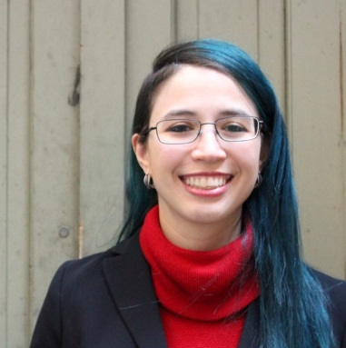
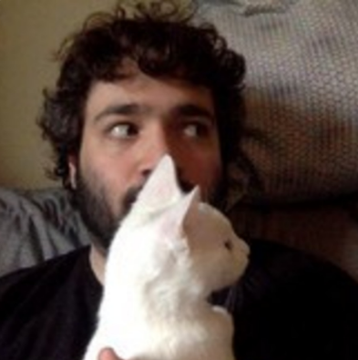
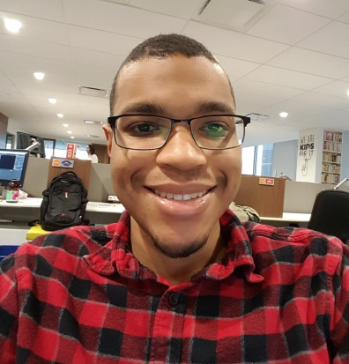
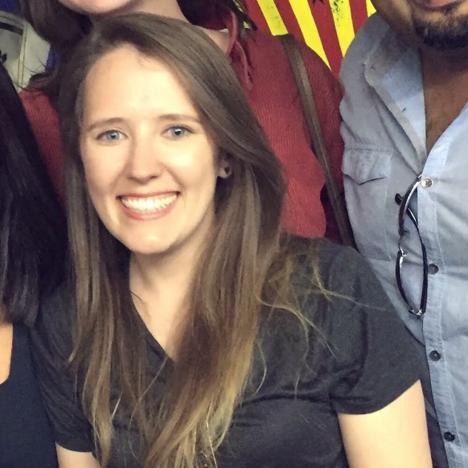
github.com/HackTheDeep/teamgoop
Jennifer Neale
Jesse Spielman
Abe Peterkin
Meret Götschel
Notes:
Thanks for listening!
Big thanks to Dr. Heiss for his help and support
If interested follow us on github!

